Slide 1
Warm up
Mental maths-
72
Is the answer, so,
what is the question?
With your partner, think of as many and tricky questions as you can…. Write then on your sticky notes and place on the board under Easy, Medium or extra Hard!
Did you use indices, square roots, decimals, BIMDAS?

Slide 2
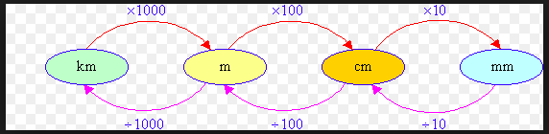
Conversion Caterpillar
What would it look like for volume?

Slide 3
Calculating Volumes of 3-D shapes
If we know the area of the face of a shape , we can just multiply that by the length, depth or height.
Such as a triangular prism
or hexagonal prism.

Slide 4
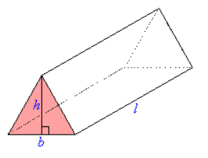

TOPIC: Measurement and Geometry
EQ: How do I find the volume of a triangular prism?
Volume of a triangular prism
Volume = Area of triangular base x Length
Volume = $\frac{b×h}{2}$ x Length

Slide 5
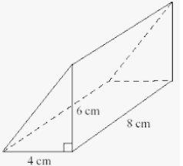

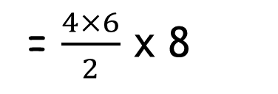
Volume = $\frac{b×h}{2}$ x Length
= $\frac{4×6}{2}$ x 8
= 96 cm³

Slide 6

EXTENSION:
First find the volume of the triangular roof, then find the volume of the rectangular prism, then add the two together.

Slide 7
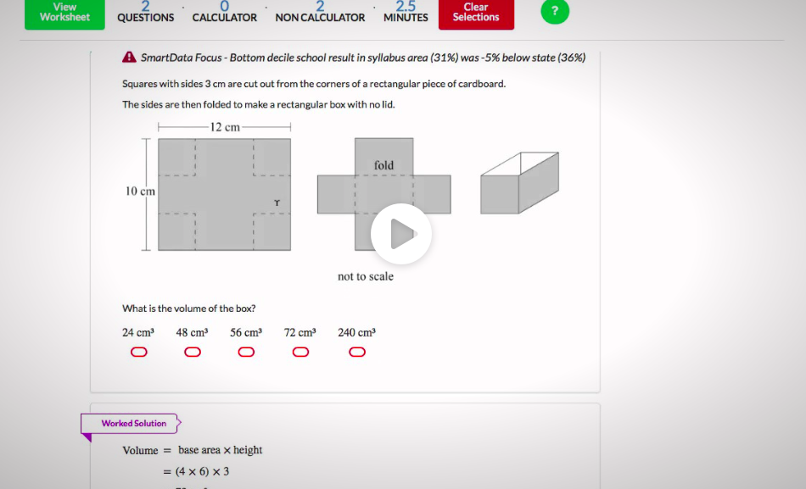
Naplan Style Question

Slide 8
Answer
First find the base,
12cm - 2(3) = 6 cm
10 - 2 (3) = 4 cm
6 x 4 = 24cm²
Then, find the height = 3cm
So, 24cm² x 3cm¹ =
**** 72 cm³ ****

